Slide 1
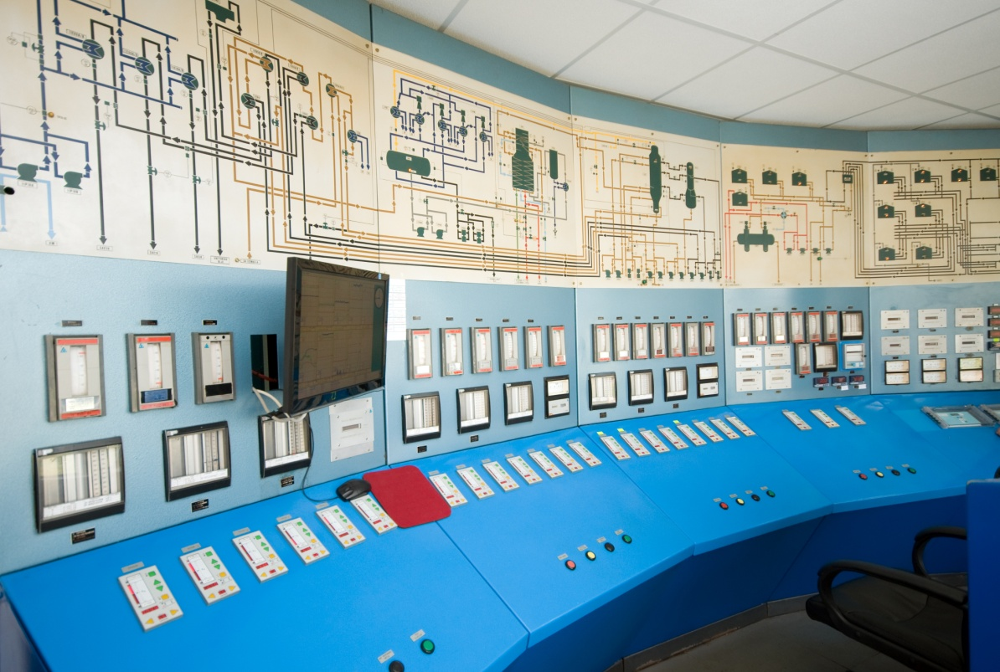
Intergraph.com Baseline Test
Version 2 | Last Updated: 02/16/2010

Slide 2

Agenda
Intergraph.com Baseline Testing
Objectives
Methodology & Sample Tasks
Audience
Feedback
Key Findings (Quantitative)
Key Findings (Qualitative)
Key Comments
Recommendations

Slide 3
Intergraph.com Baseline Testing
Objectives
The purpose of the baseline test was to evaluate how users use the Intergraph.com Web site today. This test will serve as a comparison guide for measuring improvements or regressions in a redesign. Our ultimate goal is empowering our end users to reach their goals surfing our Web site.

Slide 4
Intergraph.com Baseline Testing Methodology
The Culture of You community was solicited by email and Linked In group. Customers and Intergraph employees who responded were scheduled for a 30 minute session.
Ten Web navigating tasks were conducted via telephone and AT&T Connect conferencing system.
Users phoned in and shared their screen.
Background information was collected.
Participants were asked to vocalize their thoughts and to think aloud while they completed the tasks. For example: “I’m accessing Google to conduct a search. I type in Google.com, type in my keyword ‘music’ and hit enter.”
Actions were observed while they performed ten tasks.
Upon completion, users were asked to rate their experience and offer feedback on their site experience performing our assigned tasks.
TASKS DOCUMENTED: Number of clicks,
use of navigation or search, and time to complete.
Starting on homepage intergraph.com | 1. Please find the product “GeoMedia” in Security, Government & Infrastructure (SG&I)
 | 2. Please find product “SmartPlant P&ID” in Process, Power & Marine (PP&M)
 | 3. Please find product support on G /Technology in Security, Government & Infrastructure (SG&I)
 | 4. Please find product support for “SmartPlant Electrical,” in Process, Power & Marine (PP&M)
 | 5. Please find “shipbuilding” industry information for PP&M.
 | 6. Please find “communications” industry information for SG&I.
 | 7. Please find training courses related to “public safety” for SG&I.
 | 8. Please find training courses related to “SmartPlant Instrumentation” for PP&M.
 | 9. PP&M: Please find the PP&M customer story on Westinghouse Electric. SG&I: Please find the SG&I customer story on LSU (Louisiana State University).
 | 10. In Process, Power & Marine (PP&M) please find the P2-C2 client community. (P as in Paul, #2, C as in Cat, #2)

Slide 5
Intergraph.com Baseline Testing Audience
The sample size of this study was 20 respondents
Customers | 50%
Employees | 50%
College/PostGrad | 85%
High School | 15%
By Type
By Education
Male | 75%
Female | 25%
Light User | 25%
Medium to Heavy | 75%
By Gender
By Usage
25-45 | 55%
Over 46 | 45%
Intermediate | 45%
Advanced/Expert | 15%
By Age
By Technical Ability

Slide 6
Key Findings - Quantitative
 | Average Clicks | Average Time | Search vs. Navigate | Uncompleted Tasks
Employees | 3.39 | 34 sec. | 21% search | 12%
Customers | 3.76 | 40 sec. | 18% search | 9%
Combined | 3.58 | 37 sec | 39% search | 21%

Slide 7
Key Findings - Quantitative
 | Customers | Employees | Combined
1. Would you say that you found the Web site simple to use. | 3.5 | 3.5 | 3.5
2. Would you say you were able to successfully find your topics using this Web site. | 4.2 | 4.2 | 4.2
3. Were you able to quickly search on your topic using this Web site. | 3.4 | 3.4 | 3.4
4. How would you rate this statement: The organization of information on this Web site is clear. | 3 | 3.6 | 3.3
5. Do you think the naming and labeling of links on this Web site are clear. | 3.2 | 4.1 | 3.6
6. Would you say that the navigation on the Web site is well organized. | 3.2 | 3.7 | 3.4
7. Do you like the look of this Web site. | 4.1 | 4.5 | 4.3
Satisfaction Survey: On a Scale from 1-5 (5 being strongly agree or best and 1 being strongly disagree or worst) how would you rate your experience?

Slide 8
Key Findings - Qualitative
Design/Usability
Functionality
Copy
Information Architecture
Dislikes | Flash banners are distracting | Search doesn’t work | Titles are generic | Learning curve is quite high
 | Lack of consistency between divisions or within sections | Dual logins for Intergraph & Siebel | Too many options on a page | Everything is buried
 | Tabs need to look like tabs | Mouse sticks when trying to select PP&M or SG&I from top nav | Daunting to see so much text. | Information difficult to find
 | Layout is section specific; inconsistent between divisions | Default for Support page is last page visited | Products only have mini-description | Difficult to reach specific support page
 | Moving graphics are annoying | Training is listed differently on SG&I and PP&M | Need User Community link | Too many links on the same thing
Likes | Clean, Uncluttered, Tidy, Professional, Useful information, RSS feeds, Case Studies, Looks Nice, Informational, Task-Driven, Not Junky, Not Busy, Photos

Slide 9
Key Findings – Qualitative (continued) General Observations
SUPPORT: Users find it difficult to locate Product Support without knowledge of division. Many failed to locate correct Division Support page due to default settings, which automatically directs the user to the last used support page. Most users did not see the link CHANGE SUPPORT DIVISION, leaving them frustrated that they could not switch over regardless of path taken.
PRODUCT: Users had a difficult time locating Intergraph products because they did not know which division they were in or could not find a products link on the division homepage (hidden at the bottom of the page under More Information). A common mistake was searching for a specified product in the wrong division. Many complained that they needed to log in before accessing complete product information.
TITLES: While voicing their navigation steps, people often read Geospatially Powered Solutions instead of SG&I because it is the more prominent title on the homepage.
INCONSISTENCIES: Links: Sometimes titles are links while often they are not, forcing the user to click on the image beside the title or the tiny arrow at the bottom of the teaser. Launch of new browser window: Several links on the web site point to pdf/avi files or external pages that open up in the same browser window. Once the user clicks, they are taken off the Intergraph site and can only return by hitting the back button
TRAINING: PP&M lists courses regardless of current offerings. SG&I lists courses only on availability. Users complained of the differences between divisions.
RSS FEEDS: Currently RSS Feeds are sorted alphabetically, giving the impression that nothing has been posted in years.
REGIONAL LOCKDOWN: When you go to a region, there’s no immediate way back to www.intergraph.com – all the home buttons lock you to the region page, without access to intergraph.com from regional site.

Slide 10
Key Comments
I would like to know about updates to the software without having to search for it. Other companies let me know of updates when I launch their software. I have to keep going to the site to check on updates. RSS feeds are not being maintained.
My overall concern for someone who doesn’t know us is having to search 3-4 screens down for products might prove difficult. Without knowing that AutoCAD solutions falls under SG&I, how could someone find it? With PP&M it’s easier to draw that distinction because it’s so industry specific… Having products closer to where the viewing public lands to see what we offer would make it easier for advertising and to find what they want.
Specifically addressing the Enterprise Software link on PP&M home, I think a clear Products tab would prove more useful up top with the specifics a level down.
Your site is not web 2.0, not cutting-edge or interactive, it’s just like a 2-page brochure. It’s pretty useless without a login. Everything is locked behind the customer login. Users want to see the product and get into the nuts & bolts. When they come to find info on what you sell, they will leave scratching their heads. How many products can you sell if nobody knows about it.
My users would like to see more How-To videos on how to run the software. Also, I would like to find a presentation from last year’s User’s Conference, but don’t know where to look.
All product pages need a “more info” link. If a potential client wants to learn more about a product they can click on it. Currently the mini-description for each product is not enough. There should be a “how to talk to someone about it,” link.
I would like to see more user productivity to communicate experiences, support, tips, and tools. The Intergraph forums are not active. A web site that makes it easier to interact with the community groups would be important to me.
We should make our products SHINE. Potential clients might hear about a particular product for a particular workflow in an industry and they come looking for specific information and instead of making it sparkle, we hide it. It’s crazy to do that.
Search doesn’t work; it’s very particular or exact. Gives a huge list of text docs, which I have a hard time rifling through.
I would like to see a PRODUCTS tab on the homepage. Users shouldn’t need to know which division a product is in to find it.
The site is very complex and the learning curve is quite high, at least for new users. Say I wanted to find training, and I’m a new user, I’m not sure the logic is there to be able to find it.

Slide 11
Recommendations
COLOR-CODING & BRANDING: It would be very helpful for each division to have it’s own color theme or identity branding. This way the user knows which division he is in at all times, and when he has unknowingly switched to the opposite division.
PRODUCTS: Place Intergraph products on the top navigation, regardless of division. Feature product information accessible without a login. Include a link on each product “For more information.”
SUPPORT: Make the support link to Intergraph Product Support, regardless of Division, with specific instructions inside. It was my observation that when users were given a drop-down list of options, they clicked on it. However, when presented with instructions in paragraph form, like on the PP&M Support page, they failed to read and easily gave up. Instructions should be in a bulleted list format, rather than paragraphs of text.
COMMUNITY INTERACTION: Having a Community link may encourage more community involvement, sharing of tools, tips, solutions. Many customers expressed interest in seeing a site that promotes collaboration and interaction between users.
TRAINING: List all courses regardless of current availability. Add a waiting list and email potential clients when new courses are scheduled. Seeing course titles, regardless of current offerings, will generate more interest and/or demand for more sessions. It may also encourage clients to stay current on Intergraph software, thus maintaining greater loyalty. Also highlights the demand for more courses.
TITLES: Have PP&M and SG&I be the prominent titles on the homepage rather than Geospatially Powered Solutions or Enterprise Engineering Software.
INCONSISTENCIES LAUNCHING NEW BROWSER WINDOWS: Create a standard for launching new browser windows. IE: When linking to downloadable (pdf/avi) files or when the link takes users off the Intergraph.com site.
RSS FEEDS: If by default RSS feeds are sorted chronologically with the option to sort alphabetically, updates will be posted at the top of the list. Thus giving the impression that feeds are up-to-date, continually updated.
IMPROVE SEARCH: Often users could not find keywords such as Smart, Smartplant, P2C2, or Westinghouse. Users complain that the search needs exact words or does not render any useful results, so they rarely use it.

